Slide 1
PHD Progression 5
Explainable AI with visual analytics

Slide 2
How Does BERT Answer Questions? A Layer-wise Analysis of Transformer Representations
Proposing a layer-wise visualization of token representations that reveals information about the internal state of Transformer networks
A set of general NLP probing tasks were applied and extended by the QA-specific tasks of question type classification and supporting fact extraction
The third contribution is to show that BERT’s layers go through similar phases even if fine-tuned on different tasks

Slide 3
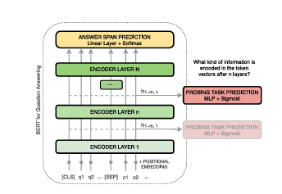
How Does BERT Answer Questions? A Layer-wise Analysis of Transformer Representations
Dimensionality reduction: BERT’s pretrained models use vector dimensions of 1024 and 512. Dimensionality reduction is used to visualize relations between tokens.
K-means Clustering: To verify that clusters in 2D space represent the actual distribution in high dimensional vector space, we apply k-means clustering.
We use principle of Edge probing

Slide 4
How Does BERT Answer Questions? A Layer-wise Analysis of Transformer Representations
We use principle of Edge probing: this translates core NLP tasks into classification tasks by focusing solely on their labeling part.
The research adopts the tasks Named Entity Labeling, Conference Resolution, Relation classification
The researcher also adds question type classification and supporting fact identification due to their importance for question answering.

Slide 5
How Does BERT Answer Questions? A Layer-wise Analysis of Transformer Representations
Named Entity Labeling: This is based on Named Entity Recognition but formulated as a Classification problem
Coreference Resolution: The Coreference task requires the model to predict whether two mentions within a text refer to the same entity.
Relation Classification: In Relation Classification the model has to predict which relation type connects two known entities.
Question Type Classification: A fundamental part of answering a question is to correctly identify its question type.

Slide 6
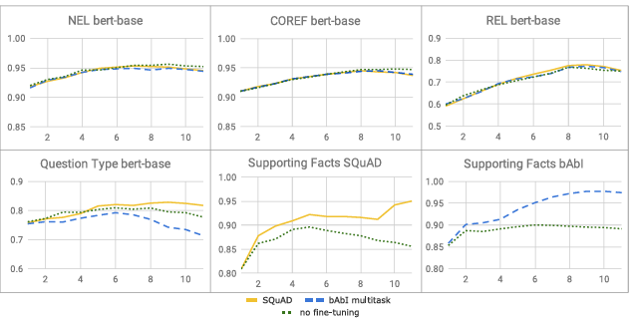
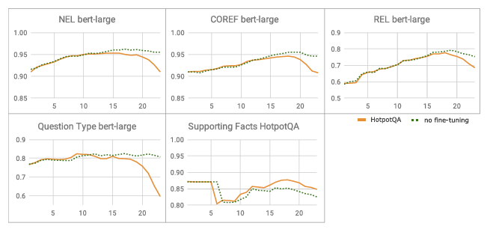
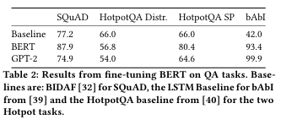
Experiment
SQUAD, HotpotQA and babI dataset
The two models these dataset was tried on was BERT and GPT-2

Slide 7
Results
Semantic Clustering: Early layers within BERT-based models group tokens into topical clusters. This clustering still holds little task-specific information.
Connecting Entities with Mentions and Attributes: In the middle layer, clustering is less connected by their topical similarities. Tokens are connected by their relation to certain input contexts.
Matching Questions with Supporting Facts: Identifying relevant parts of the context is crucial for QA and information retrieval. BERT performs this task by transforming the tokens so that question tokens are matched onto relevant tokens.
Answer Extraction: In the last network layers, the model dissolves most of the previous clusters. It then separates the correct answer token, and sometimes other possible candidates, from the rest of the tokens.

Slide 8
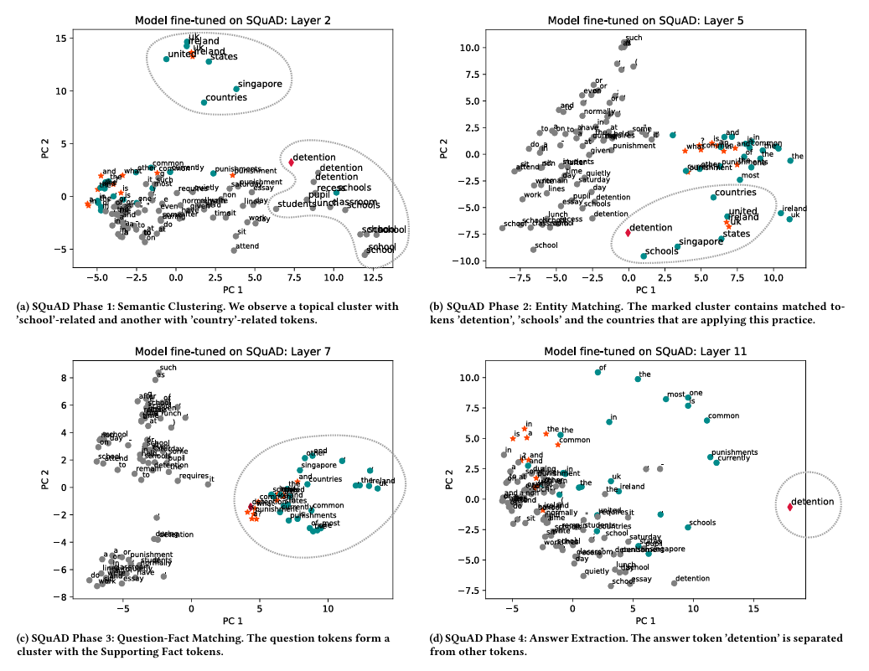
Results

Slide 9
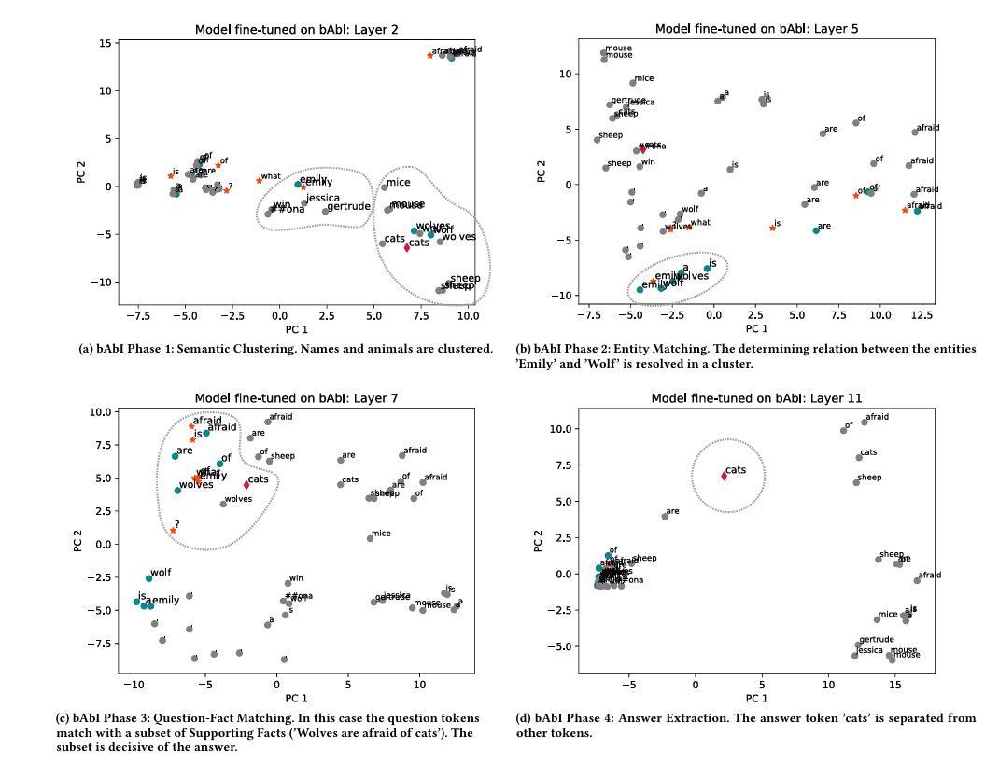
Results

Slide 10
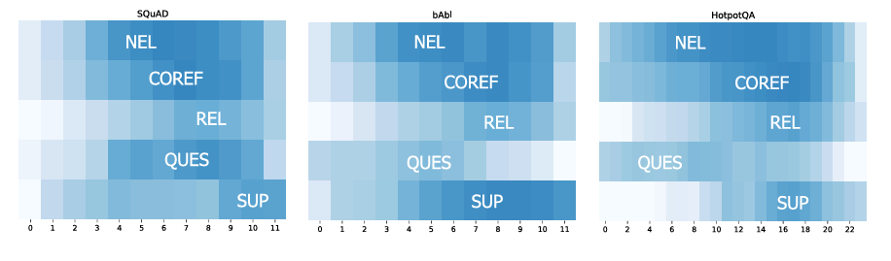
Results

Slide 11
Results
Comparison to GPT-2
Both give particular attention to the first token sequence
Attention is given to the first token in every layer, except for the Embedding layer, the first transformer block, and the last one.
separates the relevant supporting Facts and the question in the vector space
Unlike BERT the final answer is not separated but left as part of the sentence
Possible future research can be done to further probe GPT-2

Slide 12
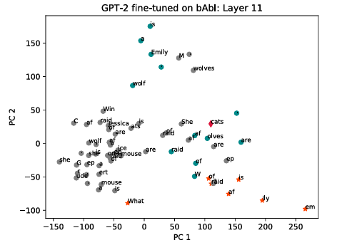
Results
While GPT-2 performs signifi cantly worse in the more difficult tasks of SQuAD and HotpotQA,
it does considerably better on bAbi reducing the validation error to nearly 0. Both tasks require positional or geometric reasoning
it is reasonable to assume that this is a skill where GPT-2 improves on BERT’s reasoning capabilities.
https://visbert.demo.datexis.com/

Slide 13
Explainable Deep Learning: A Visual Analytics Approach with Transition Matrices
the concept of mental models (MMs) and formal models (FM) to bridge the gap between human understanding and AI decision making processes
comparing a DL model with its ML counterpart or connecting a multidimensional data model with a reduced-dimensional feature space model.
the formal models employed in DL and the mental models presented as an ML model that resonates more intuitively with human cognition.

Slide 14
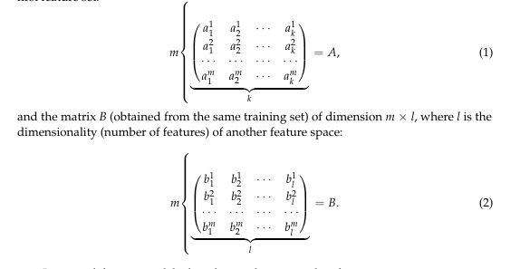
Explainable Deep Learning: A Visual Analytics Approach with Transition Matrices

Slide 15

Explainable Deep Learning: A Visual Analytics Approach with Transition Matrices
Matrix A (size m × k).
Matrix B (size m × l).
We want a conversion rule to go from A's description → B's description.
We want a matrix T such that: $B≈A×T$
if m = k = l, you could just do: $T=B×A^{−1}$
But here, m, k, l often differ, so $A^{−1}$ may not exist

Slide 16

Explainable Deep Learning: A Visual Analytics Approach with Transition Matrices
So we use pseudoinverse (a kind of “almost inverse” for non-square matrices).
$T≈A^{+}×B$
Where $A^{+}$ is the pseudoinverse of A.

Slide 17
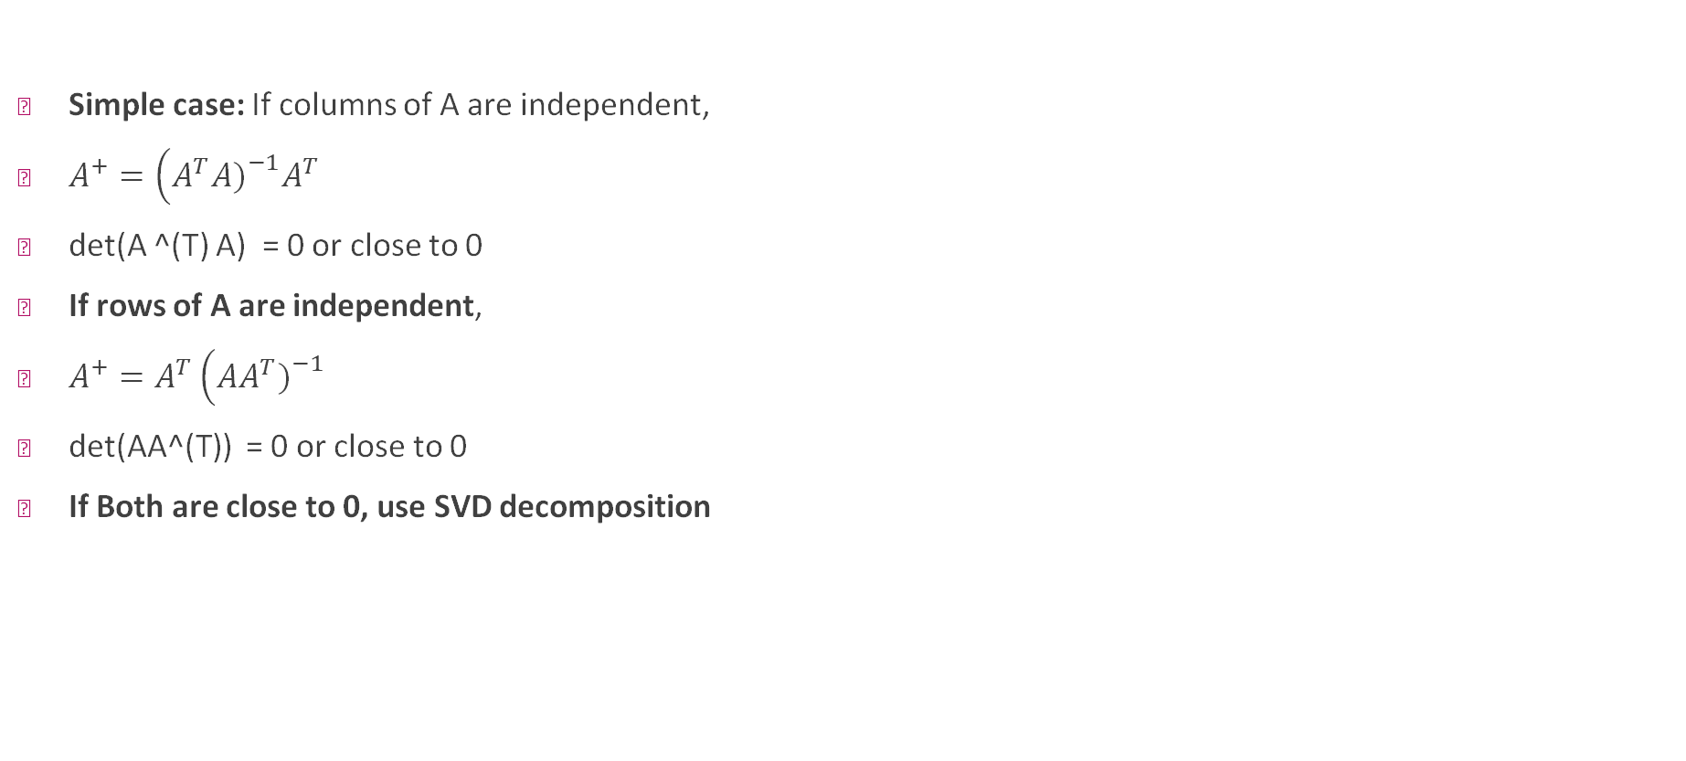
Explainable Deep Learning: A Visual Analytics Approach with Transition Matrices
Simple case: If columns of A are independent,
$A^{+}=\left(A^{T}A{\left.)\right.}^{−1}A^{T}\right.$
det(A ^(T) A) = 0 or close to 0
If rows of A are independent,
$A^{+}=A^{T}\left(AA^{T}{\left.)\right.}^{−1}\right.$
det(AA^(T)) = 0 or close to 0
If Both are close to 0, use SVD decomposition

Slide 18

Explainable Deep Learning: A Visual Analytics Approach with Transition Matrices
So we use pseudoinverse (a kind of “almost inverse” for non-square matrices).
$T≈A^{+}×B$
Where $A^{+}$ is the pseudoinverse of A.

Slide 19
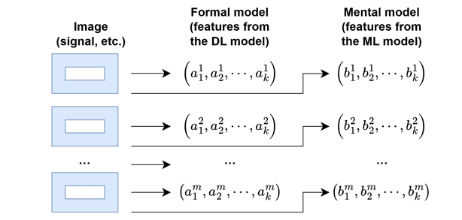
Explainable Deep Learning: A Visual Analytics Approach with Transition Matrices
Once you have T, for a new cat’s A-features a∗a∗,
b∗=a∗×T
gives its predicted B-features.

Slide 20
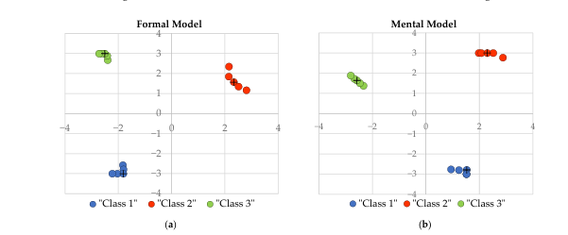
Experiment
DL models convolutional neural network and robustly optimized bidirectional encoder representations from transformers (RoBERTa)
Let us also assume that solutions to these tasks exist both through DL and ML means (for the same datasets)
MDS was used on FM output of DL A and MM output of ML B

Slide 21
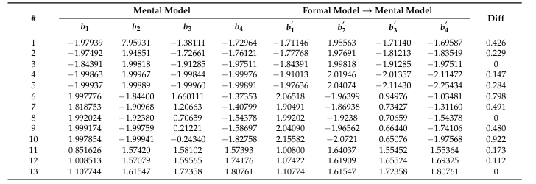
Experiment
A⁺ and Transition matrix T were calculated. This was then used to estimate the result of MM B.

Slide 22
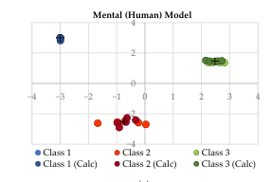
Experiment
A⁺ and Transition matrix T were calculated. This was then used to estimate the result of MM B.
Plot of initial B and B¹ Calculated with the transition matrix

Slide 23
Supervisors' comments
GPT hallucination
Digest VisBERT code
Study LLM
New framework with force connected graph
Play with attentionviz
Digest attentionviz
Have the codes for both running by January

